Slide 1
Title: Rollback Transaction in SQL
Subtitle: Undoing and discarding changes made within a transaction using the ROLLBACK statement
Presented by: Smriti Keshri
Date: 10/06/2024

Slide 2
INTRODUCTION TO TRANSACTION
Definition: A transaction in SQL is a sequence of operations performed as a single logical unit of work.
Purpose: To ensure that all operations within the transaction are completed successfully; if not, the transaction is aborted and changes are rolled back.
ROLLBACK: Used for reverting changes performed by a transaction

Slide 3
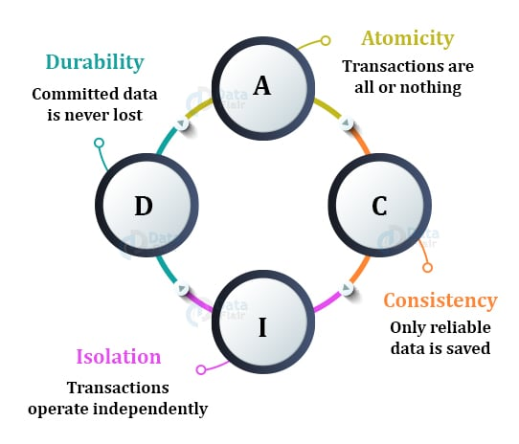
Pro
WHY USE ROLLBACK:

Slide 4
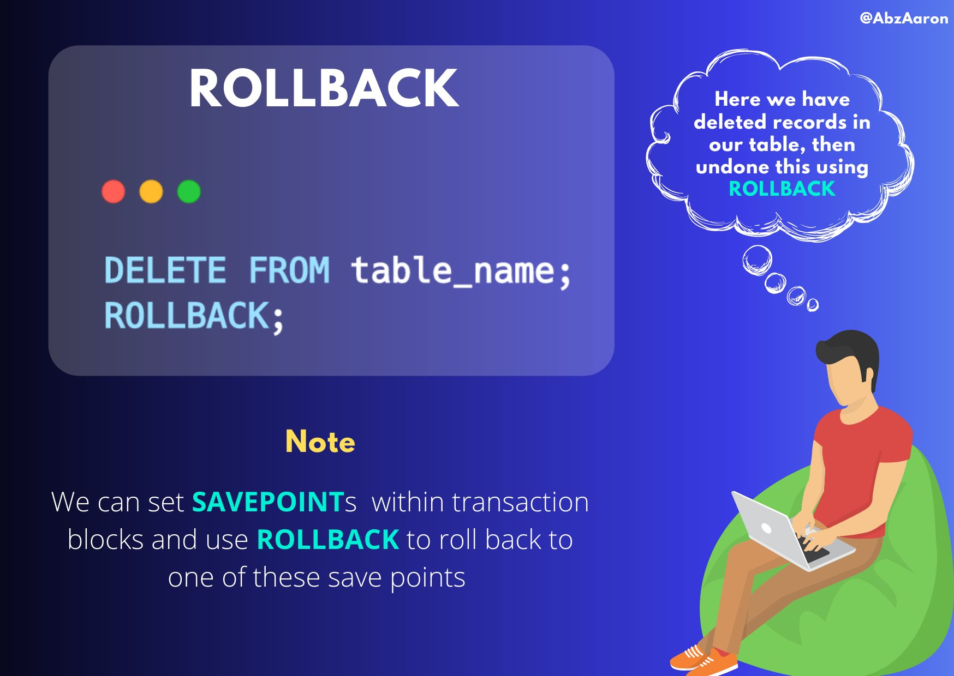
WHEN TO USE ROLLBACK:
Errors during transactions.
Incomplete or incorrect transactions.
User cancellation.

Slide 5
ROLLBACK
TRANSACTION
DELETE
UPDATE
DELETE
INSERT
ROLLBACK
COMMIT
ROLLBACK SP1
SAVEPOINT
SP1
ROLLBACK SP2
SAVEPOINT
SP2
COMMIT

Slide 6
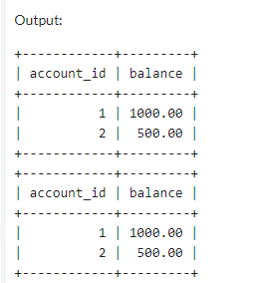
SYNTAX AND EXAMPLES
CREATE TABLE
START TRANSACTION;
UPDATE accounts SET balance = balance - 100 WHERE account_id = 1;
UPDATE accounts SET balance = balance + 100 WHERE account_id = 2;
ROLLBACK;
Revert all changes made in the tranctions
INSERT INITIAL DATA
START TRANSACTION
SQL OPERATIONS
ROLLBACK

Slide 7
Summary:
Transactions ensure data integrity and consistency.
Rollbacks allow safe recovery from errors.
Useful in error handling and debugging.
Savepoints provide additional control.

Slide 8
Thank You

Slide 9
SYNTAX AND EXAMPLES
CREATE TABLE
Implemaenting a rollback using a savepoint:
SAVEPOINT: Sets a point within a transaction.
ROLLBACK TO SAVEPOINT: Rolls back to a specific savepoint.
START TRANSACTION;
SAVEPOINT sp1;
UPDATE accounts SET balance = balance - 100 WHERE account_id = 1;
SAVEPOINT sp2;
UPDATE accounts SET balance = balance + 100 WHERE account_id = 2;
#Error after sp2
ROLLBACK TO sp2;
Only the second update is undone.
INSERT INITIAL DATA
START TRANSACTION
ROLLBACK TO SP2
SAVEPOINT SP1
SQL OPERATION
SQL OPERATION
SAVEPOINT SP2

Slide 10
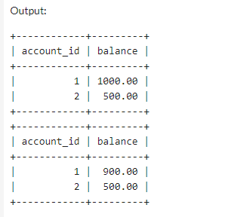
When you perform a rollback to a specific savepoint (sp2), only the changes made after that savepoint are undone.

